Slide 1
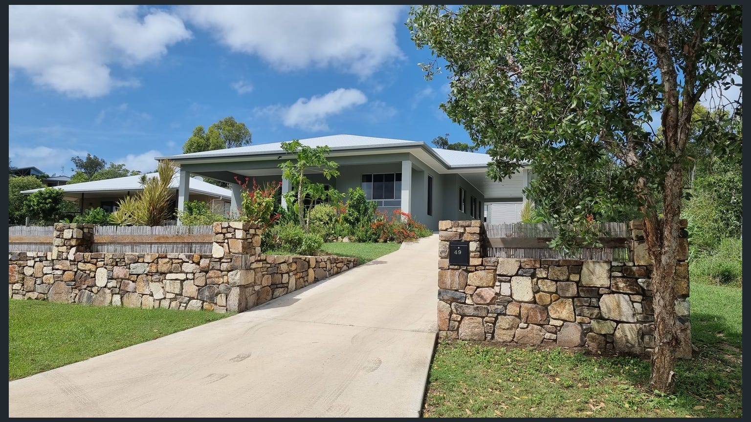
Welcome to
“Tranquillity”
by the Sea
location
Hideaway Bay
About the Place
max. Guests
8
If fishing, swimming, exploring, or chilling out and being the only person on the beach is your thing – you MUST “check in” at “Tranquillity by the Sea”
as this location is absolutely for you!
bedrooms
4
bathrooms
2
www.airbnb.com/rooms/566832741027411834

Slide 3
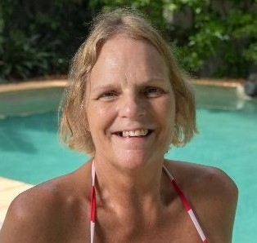
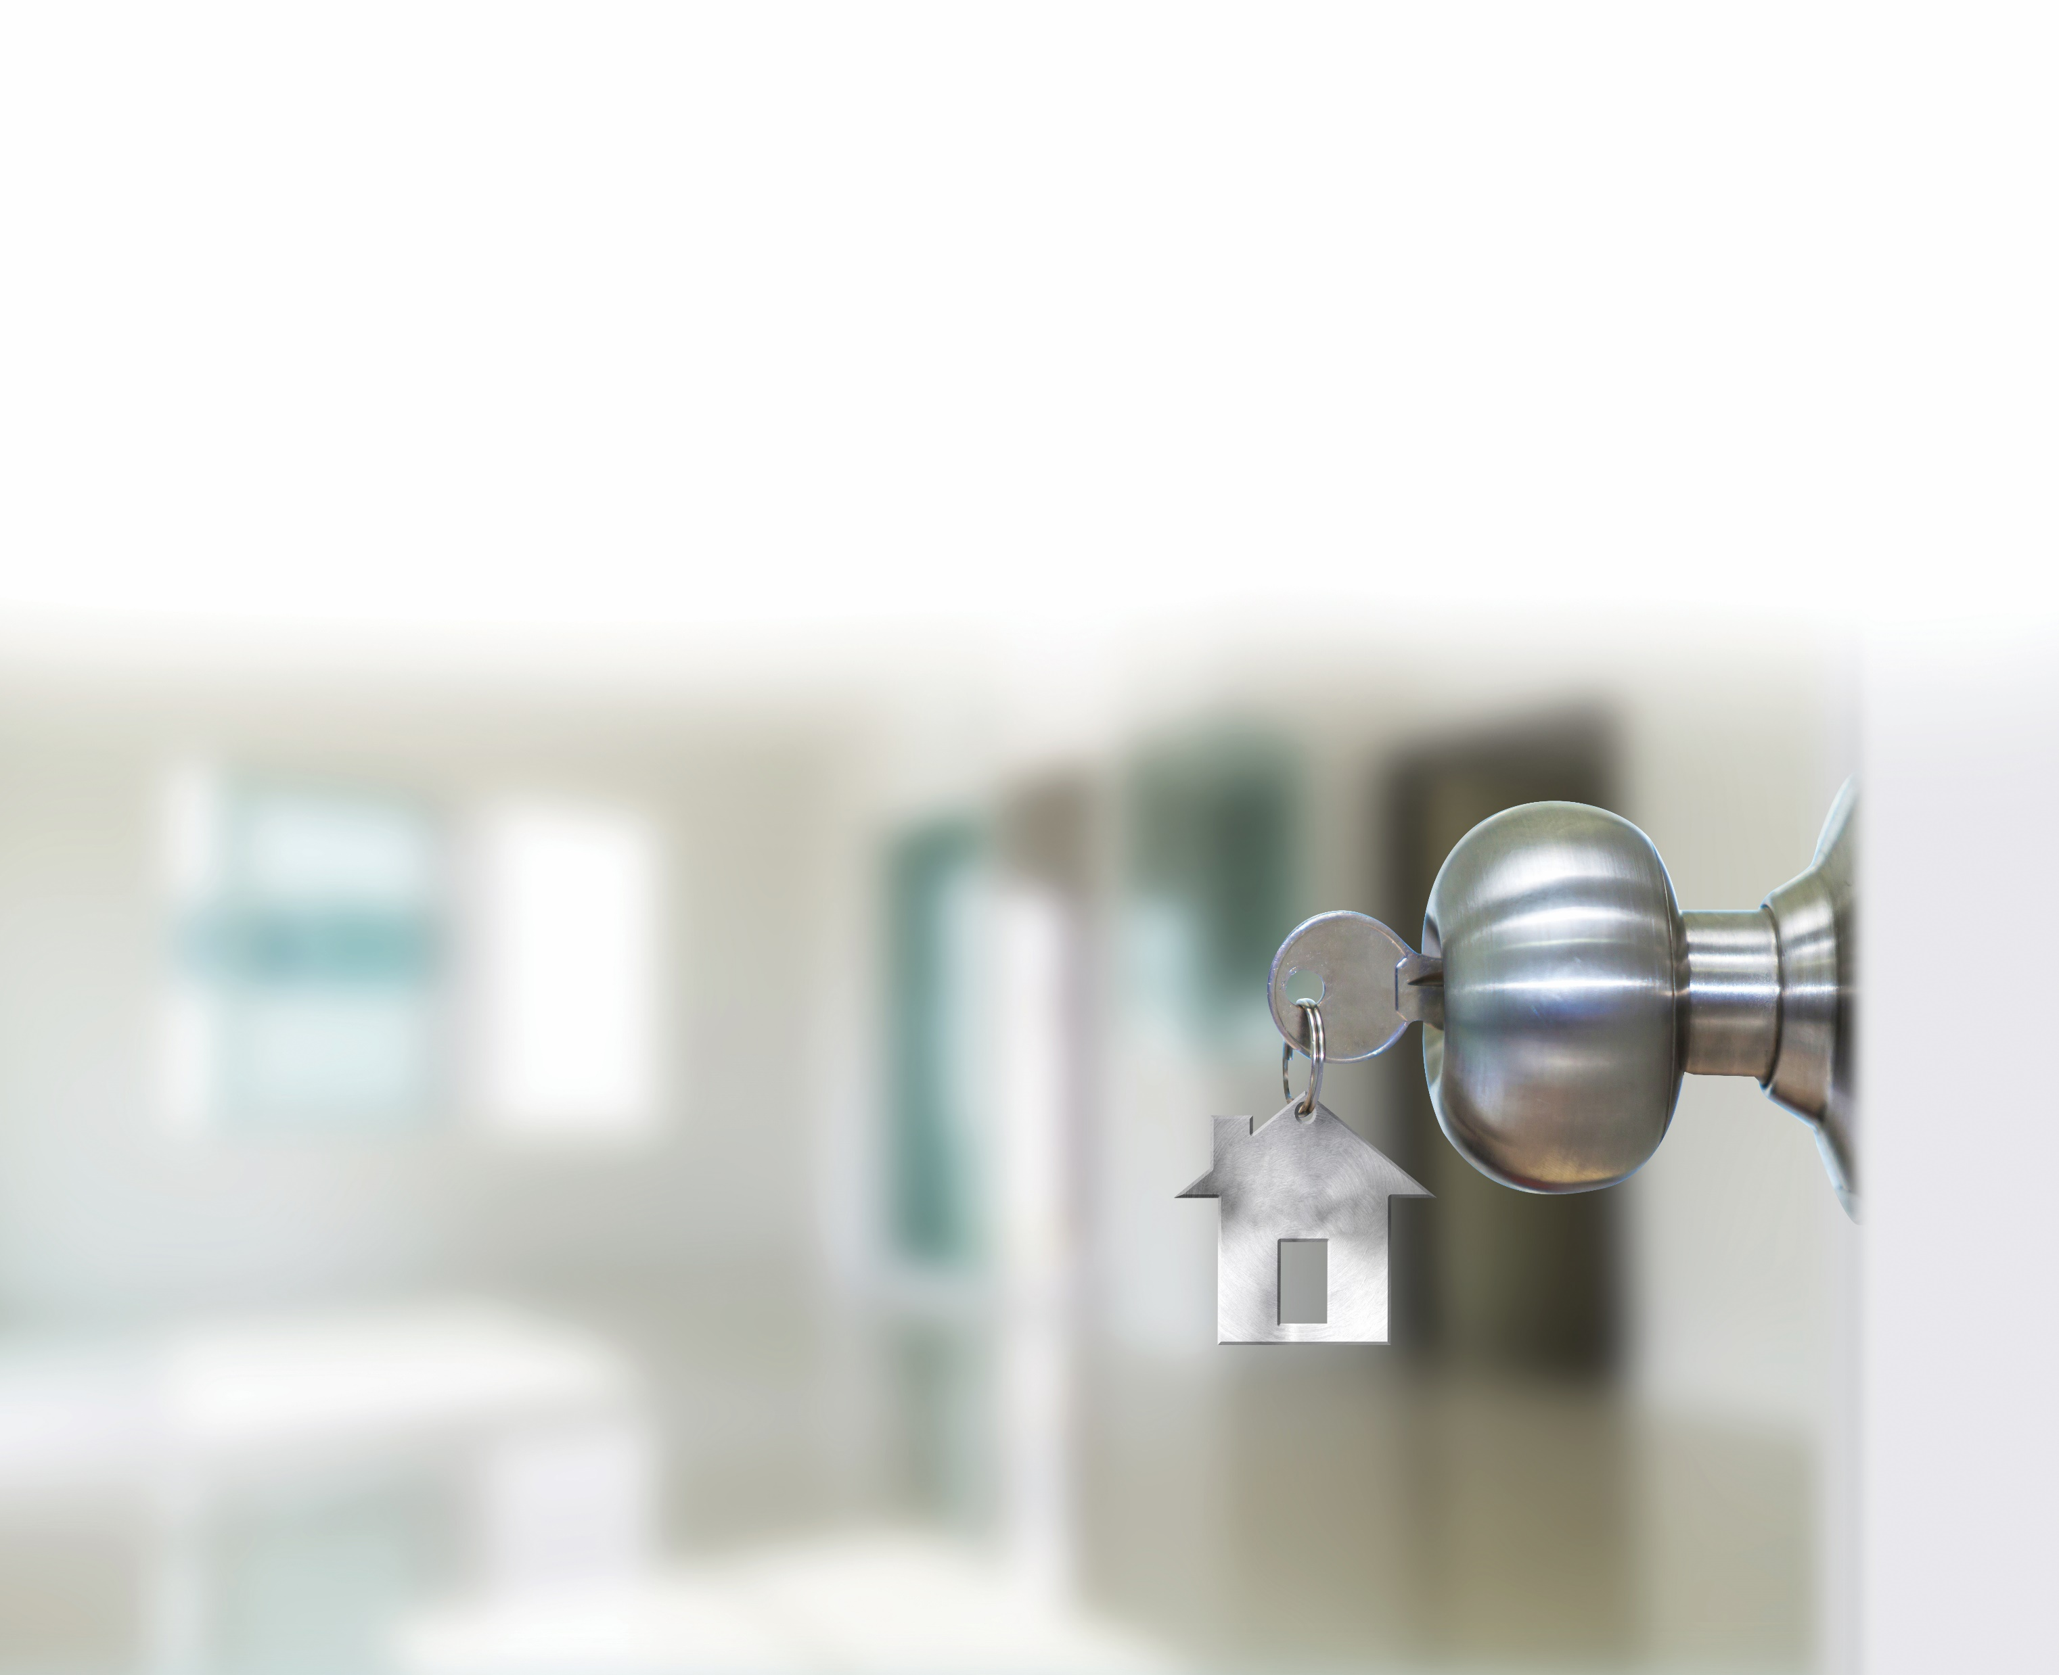
hello!
Ally
0435 125432
tranquillity@iprimus.com.au
Welcome to our home! We’re delighted that you have chosen to stay with us while you are in Hideaway Bay. This area is very special to us, your hosts, as this is where we decided to retire, and now we are glad to share this area with you!
You have full access to our house, as well as fresh towels, toiletries, and kitchen appliances etc. Please use eco-friendly settings where possible
You can contact us by phone if you need anything else while you’re here. Our number is 0435 125432 or what's app 0429 169448 if you have no mobile coverage. NB. Vodaphone has no coverage in Hideaway Bay
We ask that you respect our quiet community and keep noise levels to a minimum at night. No extra quests or parties are allowed under any circumstances, and you will be charged for any damages to the property. Please don’t smoke inside.
Don’t forget to turn off the lights and AC and lock the house when you leave
Enjoy your stay.
Emergency Info
Closest Hospital:
Proserpine Hospital
26-32 Taylor Street
Proserpine QLD 4800
07 4813 9400
Emergency Open 24/7
Closest Police Station:
Proserpine Police Station,
18 Mill St
Proserpine QLD 4800
07 49459666
Ally
tranquillity@iprimus.com.au
+61 435 125432
www.airbnb.com/rooms/566832741027411834

Slide 4
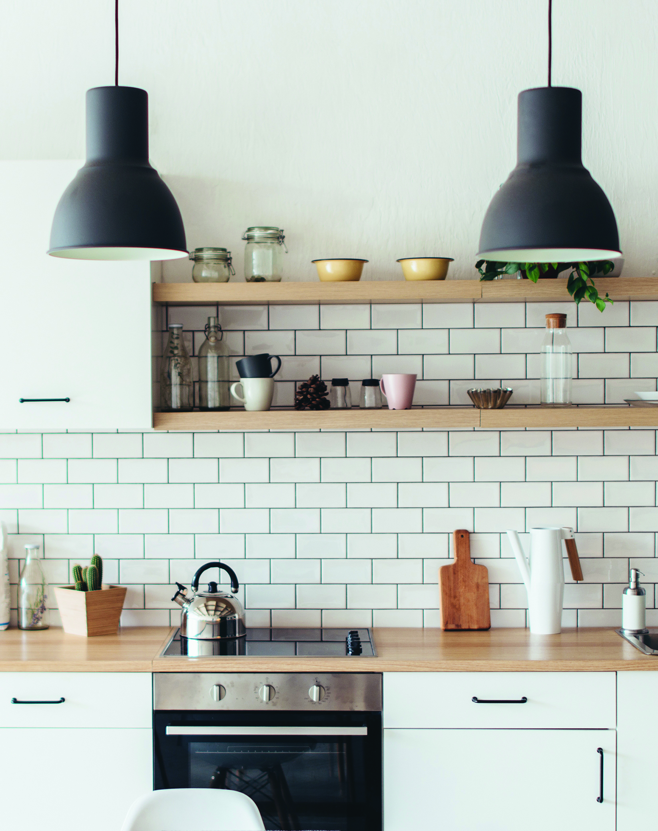
Check in
Tranquillity by the Sea
49 Gloucester Ave, Hideaway Bay
QLD 4800 Australia
Additional notes: Check in time is any time after 3pm. Please message or communicate with us if you are going to arrive earlier and we may be able to accommodate you. There is free off-street parking when you arrive.
Wi-Fi Info
network: tranquillty_2.4G
password: welcome2022
Check out
House rules:
No smoking
No parties or events
Please take your rubbish to the Tip when you leave
Please respect our neighbors and reduce noise
No animals
Please conserve our tank water
8 guest's max
Check out is prior to 10am. We do our best to accommodate late check-outs, so please get in touch with us if you need that. No need to clean before you leave, but we would appreciate the dishes placed in the dishwasher and turned on, but if you damage the home in any way, you may be charged up to $500 for damages.
Cancellations: Cancel up to 7 days before to get a 50% refund. Service fees are refunded when cancellation happens before check-in and within 48 hours of booking.
www.airbnb.com/rooms/566832741027411834

Slide 5
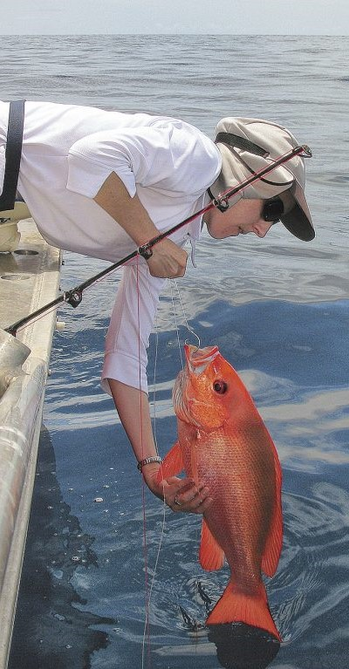
Things
to do
Hideaway bay Bowls club
Come meet the locals for barefoot bowls and a BBQ afterwards. Friday Night from 4.-30pm
Dingo beach boat hire
Hire one of Duncan's kayaks and explore our tropical waters.
Fishing
Bring you own boat, try you luck at the close islands or venture a bit further to the Shoals or Outer Reef. Or book a day out with Reel Addiction Sport Fishing Charters
Go for a walk on the sand.
The Beach at Hideaway Bay is a lovely sandy beach over 1.5km long. Covering the beachfront area along the main street Gloucester Ave, directly opposite “Tranquillity” by the Sea..
Food &
drinks
Cape Gloucester resort
Dingo beach hotel
Montes reef resort
Gloucester Ave Hideaway Bay
1 Diecke Crescent dingo beach
Gloucester Ave hideaway bay
www.airbnb.com/rooms/566832741027411834

Slide 6






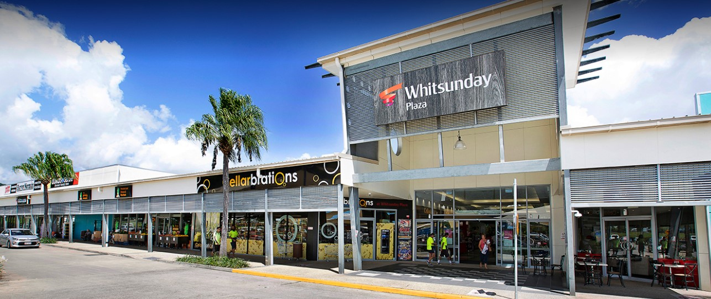
Other Supply's
Woolworths Proserpine
Cnr Herbert and main St
Proserpine QLD 4800
Mon-Sat only
IGA Proserpine
15 Mill Street
Proserpine QLD 4800
Mon-Sun
Woolworths Cannonvale
Whitsunday Plaza
Cannonvale QLD 4802
Mon-Sun
Coles
Whitsunday Shopping Centre
Cannonvale QLD 4802
Mon-Sun
Home
delivery
Woolworths
Woolworths Cannonvale deliver to Hideaway Bay Thursday evenings 5-9pm for around $15-00. Book delivery well in advance.
Coles
Coles Cannonvale deliver to Hideaway Bay Wednesday afternoon/evenings 1-9pm for around $6-00. Book delivery well in advance.
Shopping
Whitsunday Plaza
www.airbnb.com/rooms//66832741027411834

Slide 7
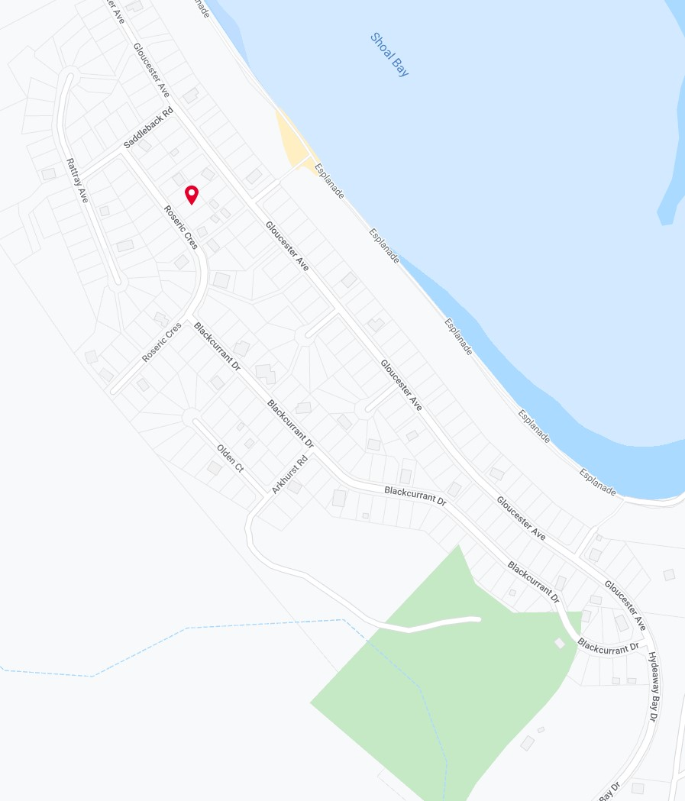
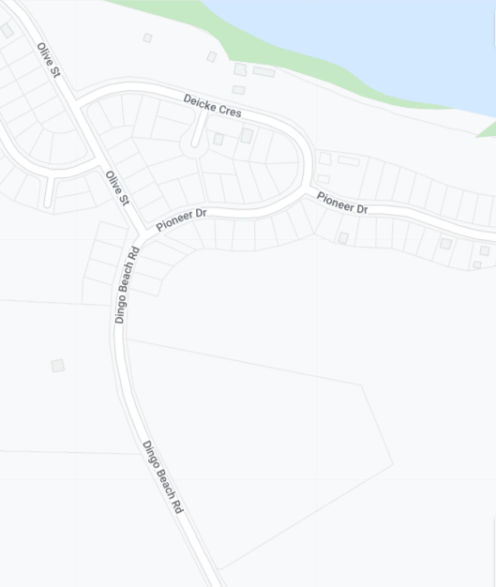
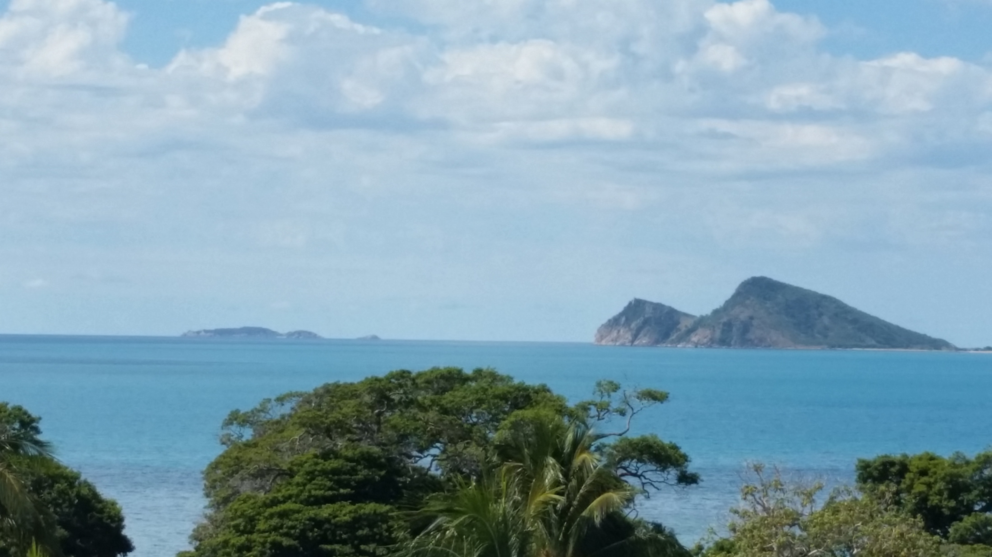
we are here
Points of
interest
3
2
We are here
4
1
Dingo Beach
Hideaway Bay
Hideaway Bowls Club
Dingo Beach Hotel
Boat Ramp, Fuel and Bait
Rubbish Tip
www.airbnb.com/rooms/5668327410274118344

